Slide 1
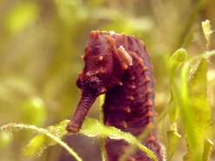
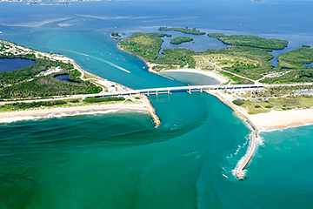
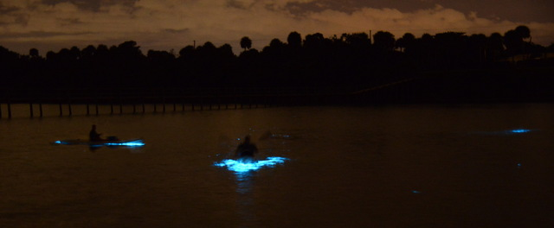
Indian River Lagoon Ecology

Slide 2
What is a lagoon?
Shallow coastal bodies of water
Separated from the ocean by a series of barrier islands which lie parallel to the shoreline.
Inlets, either natural or man-made, cut through barrier islands and permit tidal currents to transport water into and out of the lagoons.

Slide 3
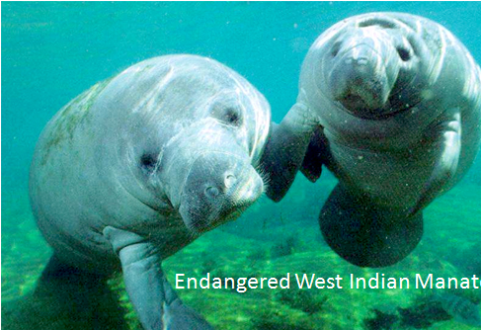
What is a lagoon?
Lagoons are classified into 3 main types:
leaky lagoons
Leaky lagoons have wide tidal channels, fast currents and unimpaired exchange of water with the ocean.
choked lagoons
Choked lagoons occur along high energy coastlines and have one or more long narrow channels which restrict water exchange with the ocean. Circulation within this type of lagoon is dominated by wind patterns.
restricted lagoons

Slide 4
What is a lagoon?
Restricted lagoons
have multiple channels, well defined exchange with the ocean, and tend to show a net seaward transport of water.
Wind patterns in restricted lagoons can also cause surface currents to develop, thus helping to transport large volumes of water downwind.
The Indian River Lagoon is a restricted type lagoon.

Slide 5
IRL Facts
156 miles long
Extends from Ponce De Leon Inlet in Volusia County to Jupiter Inlet in Palm Beach County.
Width
½ to 5 miles
Depth
Averages 3ft (0.91m)

Slide 6
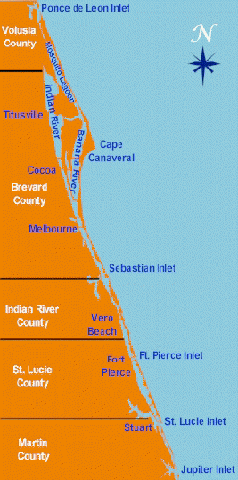
The Indian River Lagoon
is a grouping of three lagoons:
Mosquito Lagoon,
Banana River and the
Indian River.

Slide 7
IRL Facts
The Indian River Lagoon exchanges seawater with the ocean via inlets
2natural inlets
Ponce de Leon and Jupiter
3 man-made inlets
Sebastian, Fort Pierce, St. Lucie
And a lock system at Port Canaveral, which limits water exchange between the Atlantic Ocean and the Banana River Lagoon.

Slide 8
What is a lagoon?
An estuary is a place where salt and fresh water mix
Lagoons are estuaries with limited exchange with the ocean and are shallow
Creates complex ecosystem
Ranging from terrestrial to freshwater, brackish, and marine
Creates incredible habitat diversity!

Slide 9
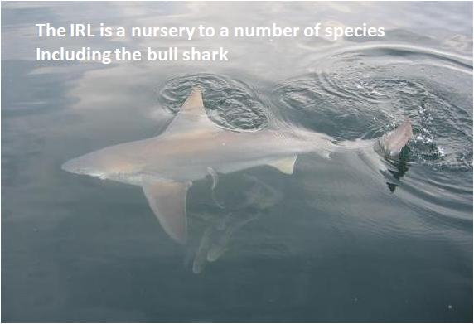
The IRL is a very unique lagoon
Straddles transition zone between colder temperature and warmer sub-tropical biological provinces
Causes high biodiversity between the northern and southern regions
Serves as a spawning and nursery ground for many different species of oceanic and lagoon fish and shellfish
The IR Lagoon is home to more plant and animal species than any other estuary in North America
more than 2,200 different species of animals and 2,100 species of plants.
The lagoon has one of the most diverse bird populations anywhere in America.
Nearly 1/3 of the nation’s manatee population lives here or migrates through the Lagoon seasonally
IRL ocean beaches provide one of the densest sea turtle nesting areas found in the Western Hemisphere.

Slide 10
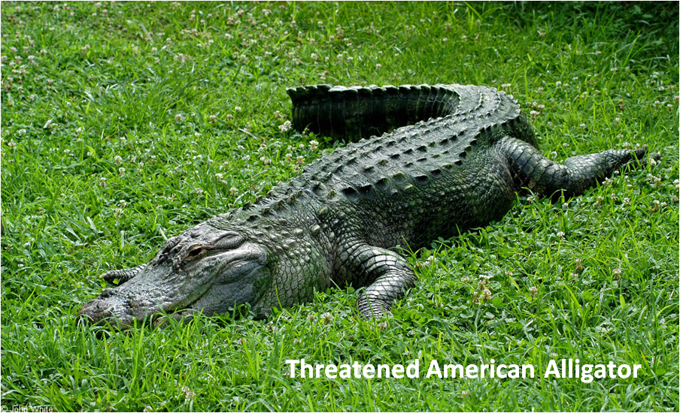
The IRL is shallow
strongly influenced by precipitation and evaporation
Heavy rains, stormwater runoff, freshwater releases, and periods of drought all contribute to fluctuations in water temperature and salinity.
However, in terms of salinity, the IRL is fairly well mixed estuary because it is also heavily influenced by wind patterns and to some extent by the tides.
The southern Lagoon has more ocean inlets so tides play a larger role in that area.

Slide 11
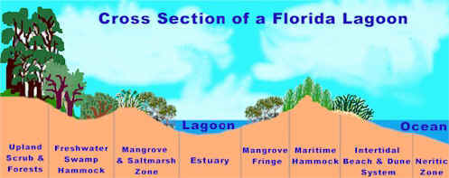
IRL HABITATS
Because of the estuarine nature and the barrier islands and sandy soil, the IRL has a variety of habitats.

Slide 12
IRL Plants
Covered by saltwater at high tide and exposed to air during low tide, many of the areas of the lagoon present a hostile environment to plants.
However, mangrove trees thrive
provide roosting areas for birds and a nursery for crabs, fish, and other creatures
Mangrove trees also filter sediments, nutrients and other pollutants from runoff before it reaches the lagoon.

Slide 13
Mangroves
The three types of mangroves found in Florida include:
Red Mangrove (Rhizophora mangle)
Black Mangrove, (Avicennia germinans)
White Mangrove, (Laguncularia racemosa).
The three are only distantly related. Each belongs to a different family.

Slide 14
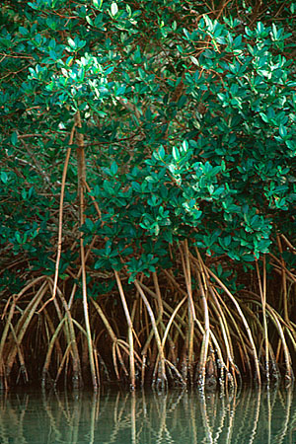
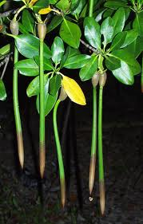
Red Mangrove
The red mangrove is the most noticeable of the three Florida mangrove trees.
It grows in the deepest water
Arching prop roots support the tree above the water as if it were walking on stilts.
Wart-like lenticels on these prop roots provide openings where oxygen can be taken in and pumped through the system to the underground roots that are growing in the anaerobic mud.

Slide 15
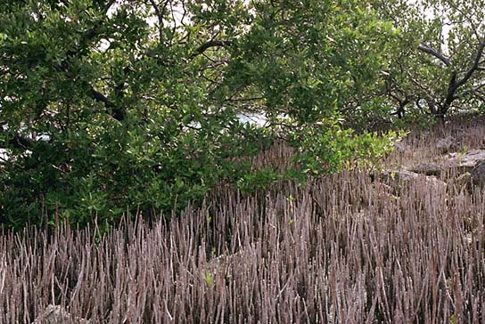
Black Mangrove
The black or honey mangrove usually forms a zone behind that of the red mangrove.
This tree takes its name from its dark scaly bark.
Black mangroves usually grow in soils that are exposed to the air at low tide but covered by high tide.
Where they seldom experience frost, black mangroves can develop into large trees over 50 feet tall.
Leaves
2 to 4 inch long, dark green above with silvery, hairy undersides
In these leaves there are special glands that excrete salt extracted from the water taken in by the roots. The salt often forms a white crust-like coating on their upper surface.
Small, white flowers which produce abundant nectar used by bees
They have no prop roots, but their root system produces many slender upright aerating roots known as pneumatophores
supply the root system with oxygen

Slide 16
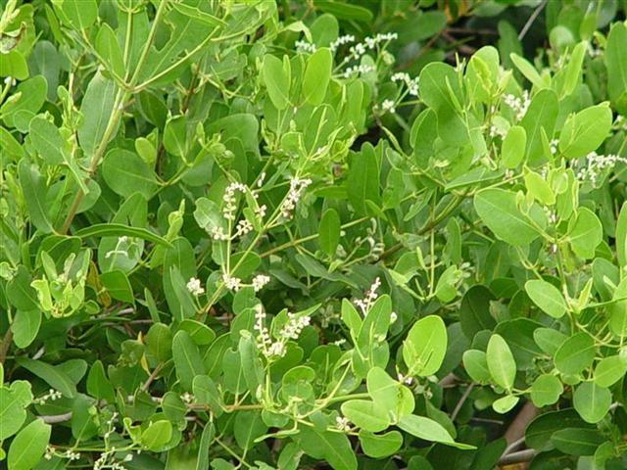
White Mangrove
White mangroves grow in sandy soils at the upper edge of the intertidal zone
Leaves are round pale green leaves, notched at the tip and have a pair of salt excreting glands on either side of their petioles.
The white mangroves have small peg roots which help anchor them in the sandy soil

Slide 17
Ecological Value of Mangroves
Every part of the mangrove forest, from the roots to the top most branches, which may reach as high as 60 feet, provide shelter or food for a multitude of creatures .
These organisms range from tiny sand flies to large tarpon offshore.
One of the birds that finds its home In the tree tops of the mangroves is the brown pelican. The pelicans share their "rookeries" with egrets, herons. wood storks, ospreys, and cormorants.
Raccoons favor the coon oysters that live on the prop root of the red mangrove.
Spiders weave many webs to catch unsuspecting insects.
Snakes slither up the tree trunks after birds' eggs and nestlings
cormorants dine chiefly on the fish in the nearby waters.

Slide 18
Ecological Value of Mangroves
However, when the tide comes in covering the roots and pneumatophores of the mangrove forest, it becomes part of a marine nursery.
The mangrove forest provides a place where young fish, as well as other organisms such as blue crabs, are protected from predators and competing species which are unable to enter the lower salinity water.
Oysters, barnacles, and sponges along with the ribbed mussels are found in great quantities in the mangrove root zone.

Slide 19
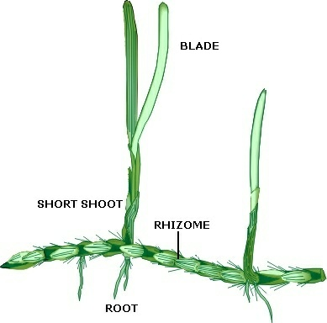
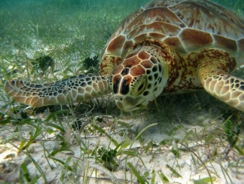
Seagrass
Seagrasses are flowering vascular plants that inhabit shallow areas of oceans, estuaries, and lagoons worldwide.
They are the only flowering plants that live their entire lives totally in seawater.
Seagrass beds are one of the most important habitats of the Indian River Lagoon.
6 species – includes turtle grass, shoal grass, and manatee grass

Slide 20
Seagrass meadows
In the Lagoon, these seagrasses form “meadows”, which are spawning areas where the grass grow up to three feet tall.
They provide habitat for many organisms and form the basis of the food web
Bay scallops, blue crabs and spotted sea trout are examples of species that depend on seagrass beds.
Seagrasses are also a major part of the diets of manatees and sea turtles
substrate for epiphytic (attached) algae, a critical component of the marine food web.

Slide 21
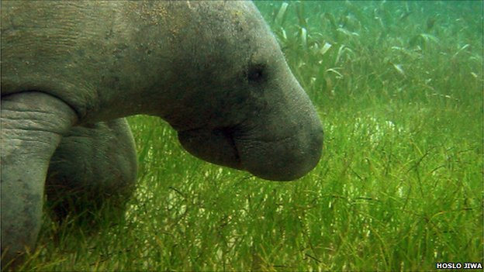
Seagrass
Within the Indian River Lagoon, seagrass is a primary indicator of overall estuarine health. The extent and health of the seagrass community is dependent on good water quality and is a good indicator of water quality trends in the IRL.

Slide 22
Seagrass
Interpretation of aerial photographs taken in 1943 of the IRL found approximately 62,000 acres of seagrass in the IRL. This figure has served as a benchmark for seagrass restoration in the IRL.
Seagrass surveys done in 1992 found approximately 58,000 acres of seagrass with substantial losses of seagrass acreage (up to 80 percent) in most urbanized segments.
Over the past 20 years, losses of seagrasses along the lagoon have been severe, with some areas losing up to 95 percent of their coverage. Other areas, however, have remained stable and productive.

Slide 23
Impacts to Seagrasses
Reduced light transmittance through the water column has been one of the major factors implicated in losses of seagrass coverage.
Several factors are important in reducing light penetrating to a given depth of the water column:
Absorption by other floating vegetation.
Suspended and dissolved substances input into lagoon.
Color of water due to dissolved organic materials.
Eutrophication (excessive organic production and nutrient

Slide 24
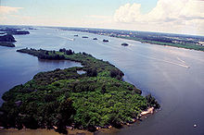
Spoil Islands
Over 200 Spoil islands were created in the 1950s when the Intercoastal was dredged.
The excess dirt was just piled up and created these islands.
Although the dredging did significant damage to seagrass beds, over time the islands are now home to mangrove trees.

Slide 25
OYSTER REEFS
Oyster reefs in Florida are found in nearshore areas and estuaries of both coasts, but grow especially vigorously near estuarine river mouths where waters are brackish and less than 10 meters deep.
In addition to being commercially valuable, oyster reefs serve a number of important ecological roles in coastal systems:
providing important habitat for a large number of species
improving water quality
stabilizing bottom areas
influencing water circulation patterns within estuaries.

Slide 26
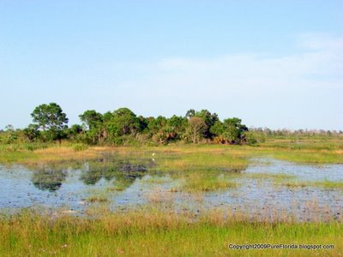
SALT MARSHES
By the 1970s, 75 percent of lagoon salt marshes were lost. Dikes built to separate 40,400 acres from the lagoon to control mosquito breeding eliminated juvenile fish nursery grounds.

Slide 27
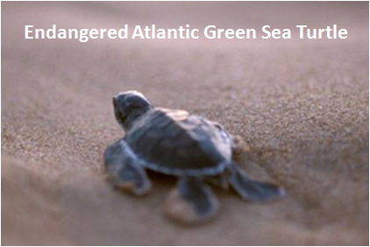
A Lagoon in Peril
One of the more prevalent ecological problems to the Indian River Lagoon is storm water runoff.
comes from our roadways, parks, golf courses and other sources.
Every summer storm sends millions of gallons of runoff into the lagoons sending petroleum products from roadways and nitrates/phosphates and other chemicals from yards and manicured landscaping.
Wastewater and stormwater discharges deposit freshwater and pollutants promoting algal growth and seagrass destruction.

Slide 28
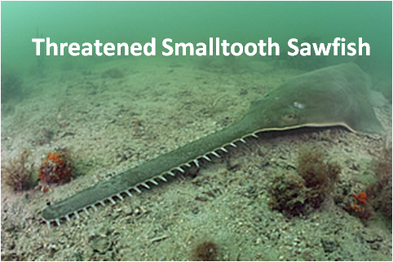
A Lagoon in Peril
In 1985, 45 domestic Wastewater Treatment Plants discharged more than 39 million gallons per day of treated wastewater to the IRL.
These plants discharged more than 1.7 million pounds of total nitrogen, 400,000 pounds of total phosphorous and 1.5 million pounds of total suspended solids to the IRL each year.
While raw sewage has been greatly eliminated from the lagoon, treated sewage and waste are evasive and killing tens of thousands of acres of sea grass each decade.

Slide 29
A Lagoon in Peril
St. Johns River marshes and Lake Okeechobee discharges are drained into the lagoon.
Excessive freshwater degrades shellfish habitat and carries soils and pollutants (primarily nitrogen and phosphorus) into the lagoon, fostering algal growth and killing sea grasses.

Slide 30
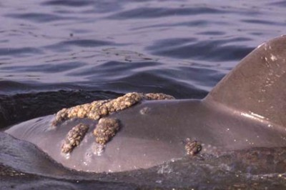
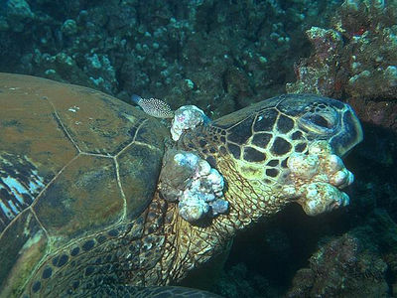
A Lagoon in Peril
Seagrass beds and mangroves are destroyed and dredged for building
Contaminants in the IRL contributing to:
Eutrophication
Immunosuppression in marine animals
Depletion of marine organism populations
Occurrence of antibiotic resistant bacteria in the lagoon
Dolphin with lobomycosis
Turtle with papillomavirus

Slide 31
Progress
The Surface Water Improvement and Management (SWIM) Act of 1987 (Chapter 373.453 373.459, Florida Statutes) was established to aid in the restoration of priority water bodies throughout Florida.
Restoration of oyster reefs
Protection of mangrove and seagrass areas
Contamination monitoring

Slide 32
http://www.teamorca.org/cfiles/about_orca.cfm
http://www.floridaocean.org/p/2/home
http://www.sms.si.edu/

Slide 33
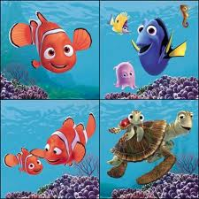
Remember all drains lead to the ocean!

