Slide 1
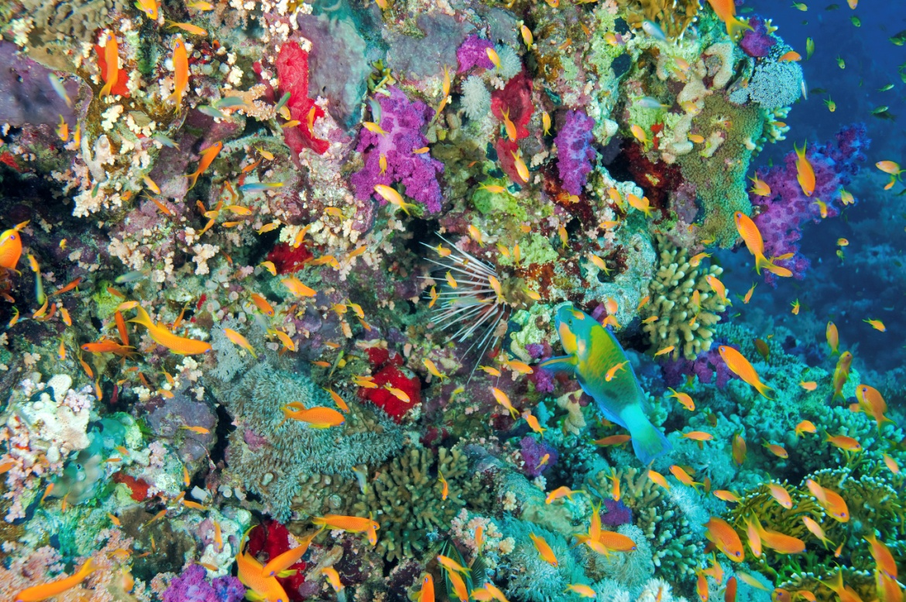
EXPLORING MARINE ECOSYSTEMS
All ecosystems contain biotic and abiotic factors
Biotic = living features
Abiotic = non-living physical features
Relationship between biotic and abiotic factors is important to ecosystem health

Slide 2
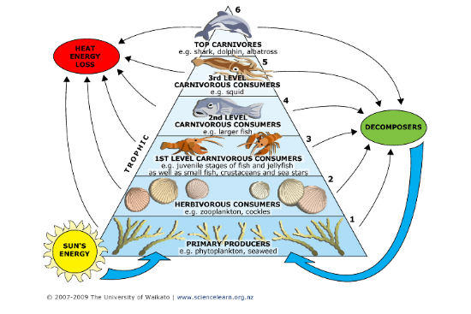
ENERGY FLOW THROUGH MARINE ECOSYSTEMS
ABIOTIC Features:
Solar energy (sunlight)
Heat energy (transformed from sunlight)
Kinetic energy (movement of seawater, wind, substrate (sea floor sediment), and organisms moving
BIOTIC Features:
Trophic Levels 1 - 6 on pyramid
Level 1 -Aquatic plants = primary producers (photosynthesizers)
Level 2- Herbivores (plant eaters)
Herbivorous omnivores
Levels 3 to 6 – Carnivores of who eats who (eater of smaller animals than self)

Slide 3
Inshore 1. Estuaries 2. Mangrove forests 3. Salt marshes 4. Rocky shores 5. Seashores Offshore 6. Coral reefs 7. Kelp forests 8. Open ocean 9. Deep sea 10. Polar seas
Types of Marine Ecosystems

Slide 4
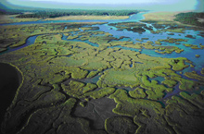
1. ESTUARIES Estuaries provide buffers against coastal storm impacts from wind & waves
ABIOTIC Features:
Shallow, brackish water from mixture of inland fresh water & rain with seawater by daily tidal motion
BIOTIC Features:
Rich in organic material (detritus)
Marine nursery areas for many commercial marine organisms and recreational fish species
Seagrass beds in tropical areas drift algae

Slide 5
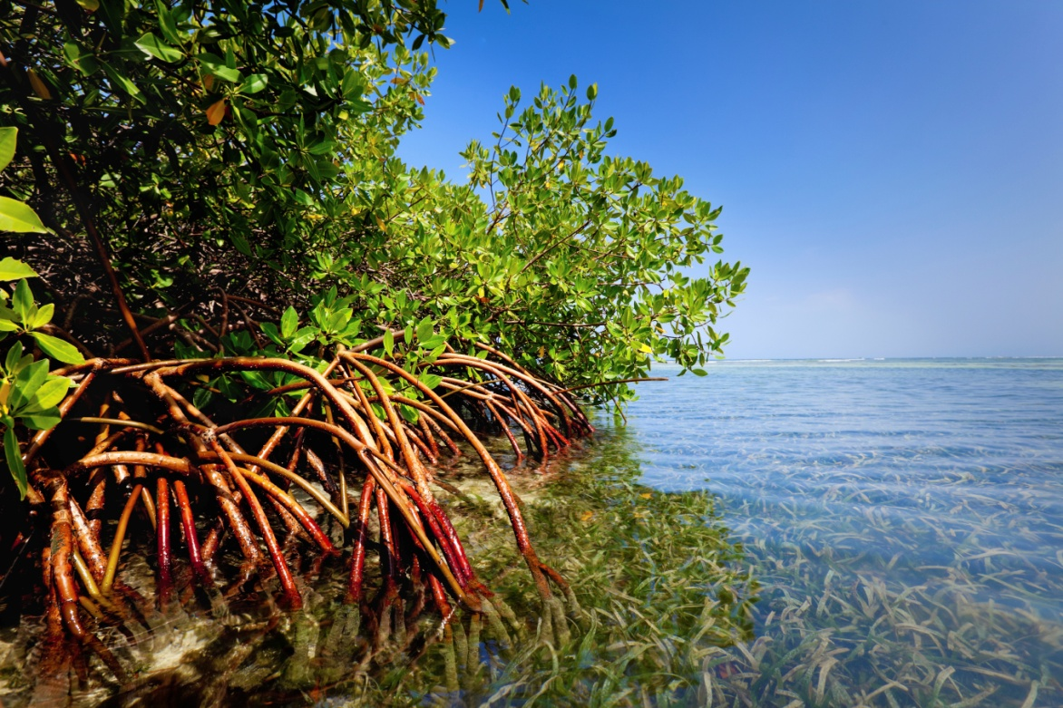
2. MANGROVE FORESTS mangrove trees are not a single species, but actually a group of more than 50 different types of species!
ABIOTIC Features:
Warm temperatures
Other abiotic – mud, shallow water, warm temps, many nutrients
BIOTIC Features:
Rich in organic material
Tree roots covered with water in high tide
Nursery to many growing organisms
Biotic – red mangroves, snails, crabs, barnacles, oysters, plankton, snapper
Add Picture

Slide 6
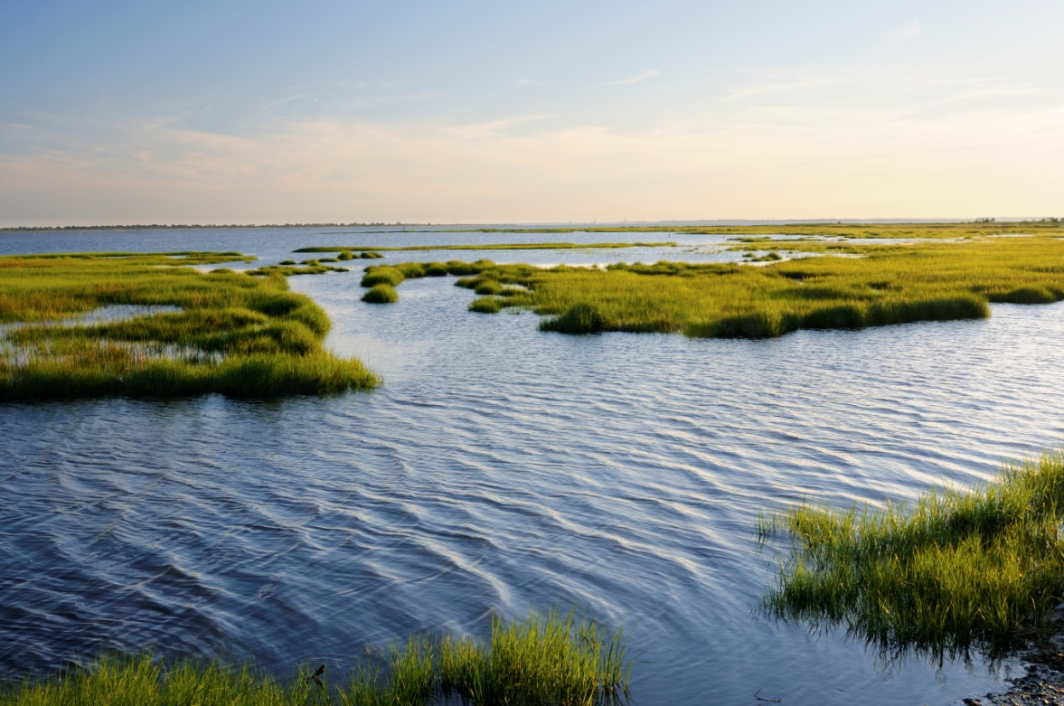
3. SALT MARSH salt marshes exist in estuaries along coasts
ABIOTIC Features:
Extra-tropical estuary in temperate climates (cooler than tropics)
Wet and dry, as influenced by tides and precipitation
Long grass and thick mud from decomposition and nutrient cycling
Brackish water, shallow and from mixture of inland fresh water & rain with seawater by daily tidal motion
BIOTIC Features:
Rich in organic material as substrate (sediment on bottom)
nursery areas for many commercial marine organisms and recreational fish species
tall grass, small fish, crabs, lobsters, shrimp
Add pictures

Slide 7
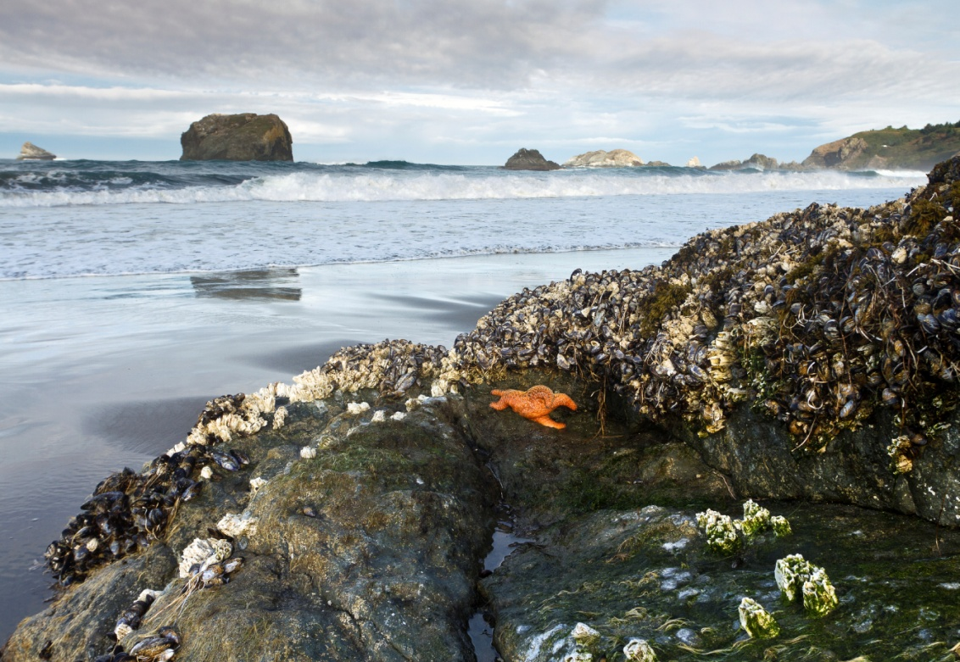
4. ROCKY SHORE Rocky shores are shoreline areas of high energy where sea water and wave action meet rock formations
ABIOTIC Features:
Harsh habitat between high and low tide
Organisms can alternate between wet and dry habitat areas
Wave action
BIOTIC Features:
crabs, barnacles, mussels, many varieties of marine invertebrates
Sessile (attached) seaweeds
Add Pictures

Slide 8
5. SEASHORE where waves interact with sandy beaches
ABIOTIC Features:
The seashore is a very dynamic habitat between high and low tide where conditions can be calm or harsh
Organisms can alternate between wet and dry habitat areas
Wave action constant and variable
Sand dunes
BIOTIC Features:
Many varieties of marine invertebrates (no backbone) and shore birds (seagulls, pelicans, osprey, etc.)
Migrating sea life common near shore
Most plant life is attached plants rooted along dunes & some drift algae

Slide 9
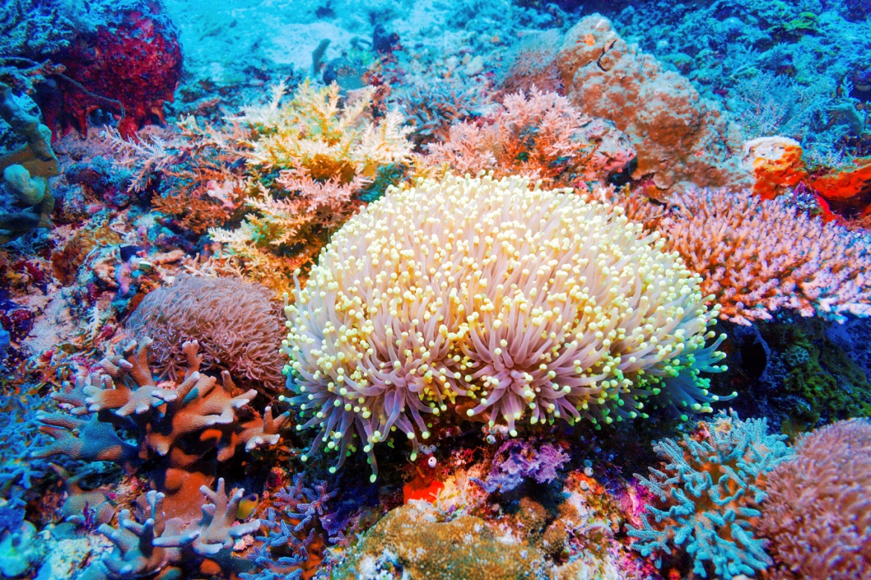
6. CORAL REEFS are marine communities thought to be the most taxonomically diverse of all ecosystems
ABIOTIC Features:
Coral reefs are in shallow, sunlit (photic zone), warm water offshore areas
Hard, calcium-based formation built from floor up (calcium carbonate)
Other abiotic components – sunlight, rocks, shells, shipwrecks
BIOTIC Features:
Very biodiverse; many different organism species
Colorful polyps (marine invertebrates that secrete
Other biotic components – coral, butterfly fish, parrot fish, reef shark, seaweed, barracuda
Add Picture

Slide 10
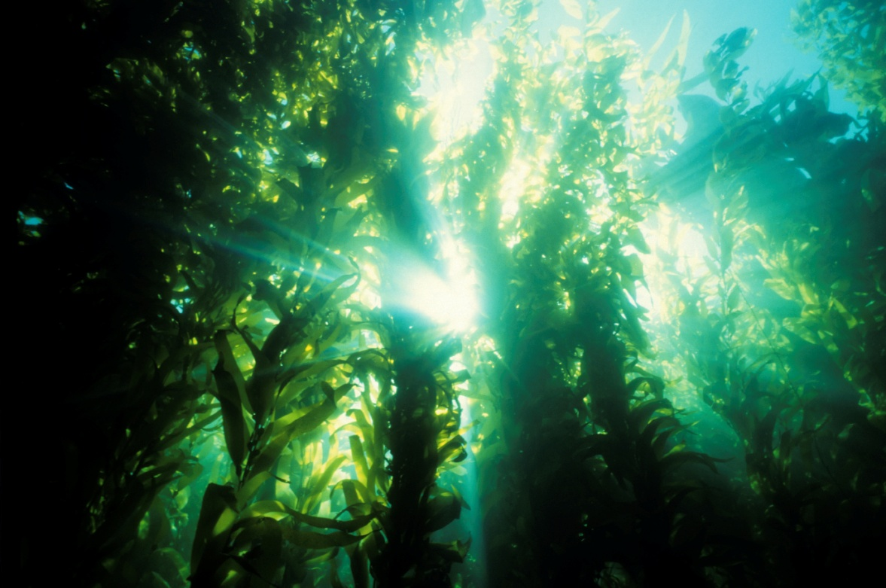
7. KELP FOREST where cold ocean currents flow nearshore bringing many types of nutrients for plant & animal life
ABIOTIC Features:
Kelp forests are in sunny but cold nearshore habitat
Clear & cool water conditions carrying many types of important nutrients
BIOTIC Features:
Looks like a dense forest of Kelp growing from the seafloor to the surface
giant kelp, sea otters, sea urchins, mussels, crabs, snails
Add Pictures

Slide 11
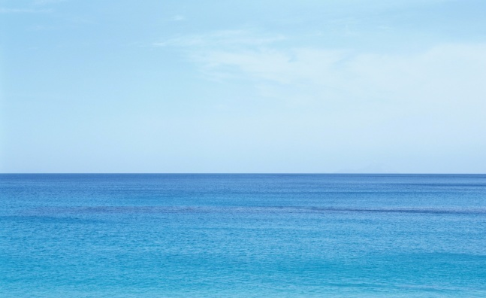
8. OPEN OCEAN areas of ocean water that are not near shore
ABIOTIC Features:
The open ocean is offshore and beyond the continental shelf and tidal influence
Clear ocean water moving because of winds and major ocean currents
BIOTIC Features:
Large schools of fish and mammals
Sunlight in near surface so only plankton or drift algae as plant life (phytoplankton)
Whales, sharks, schools of fish, and plankton (drifting) zooplankton
Add picture

Slide 12
9. DEEP SEA is the ocean area that is so deep that sunlight does not reach so it is absolutely dark… the no light zone
ABIOTIC Features:
The Deep sea is a no light or aphotic zone so there is no photosynthesis
Extreme pressure
Cold water
BIOTIC Features:
Angler fish, jellyfish, squid, octopus, giant clams
Some organisms communicate by bioluminescence & fluorescence (chemical reactions using protein molecules that can flash light)

Slide 13
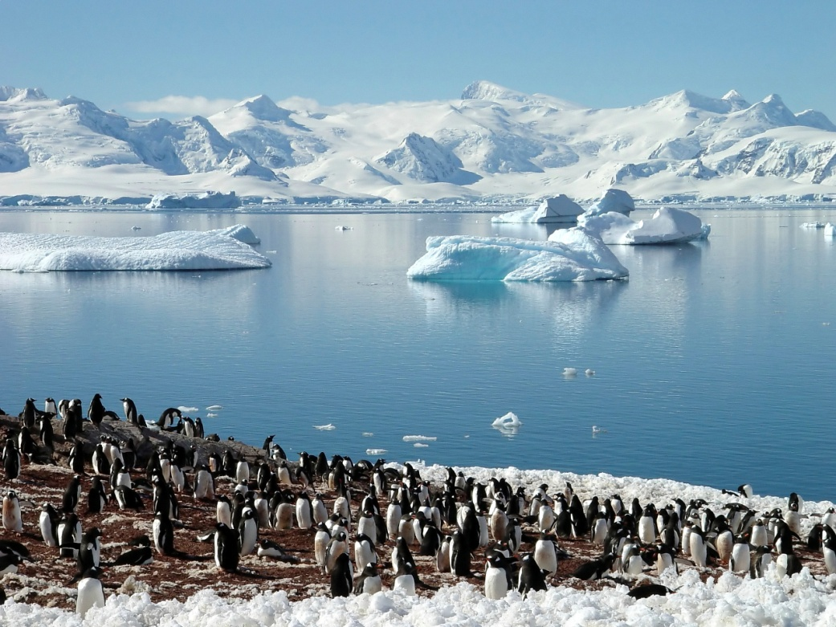
10. POLAR SEA Despite the harsh weather and the ice cover, polar seas are teeming with life
ABIOTIC Features:
Cold water & little sunlight parts of the year
Dominated by ice ( ice bergs ) and snow, cold temps, long hours of summer sunlight
BIOTIC Features:
Animals include polar bears, beluga whales, orcas, krill, seals, penguin
Plant life is phytoplankton
Polar marine food-chain that starts with the smallest photosynthesizing organisms in the sea
followed by the organisms that eat plant-material, and
Top of the chain are very large carnivores like Polar bears and Orcas
Add Pictures

Slide 14
Key Vocabulary Writing Assignment: find & write definitions for Inshore Ecosystems & Offshore ecosystems
Inshore VOCABULARY:
Ecosystems
Biotic
Abiotic
Trophic
Transformed
Sediment
Photosynthesizers
Herbivores
Omnivores
Carnivores
Estuaries
Brackish water
Organic matter
Detritus
Marine nursery
Seagrass beds
Drift algae
Species
Mangroves
Plankton
Salt marshes
Temperate
Precipitation
Decomposition
Substrate
Rocky shores
Alternate
Habitat
Invertebrates
Sessile
Interact
Seashore
Dynamic
Variable
Sand dunes
Migrating
Offshore VOCABULARY:
Communities
Taxonomically
Coral reefs
Photic zone
Calcium carbonate
Biodiverse
Marine polyps
Kelp forests
Kelp
Nutrients
Urchins
Open ocean
Continental shelf
Ocean currents
Marine mammals
Phytoplankton
Zooplankton
Deep sea
Aphotic zone
Bioluminescence
Fluorescence
Polar sea
Ice bergs
Food-chain

Slide 15
For → Estuaries, Mangrove Forests and Salt marshes http://education.nationalgeographic.com/media/file/Mangrove-ecosystem-spanish.jpg
More to EXPLORE…About the Types of Marine Ecosystems…
Websites about Inshore Ecosystem
Also → Explore by Using Kilroy Academy:
1. To access the website, visit www.kilroyacademy.org.
2. Click on the resources tab to view available STEAM resources.
3. Resources are organized by topic (Aquatic Ecosystems, Depth, Temperature and Salinity) categorized by subject (Science, Technology, Engineering, Art and Math).
4. Click on the colored subject headings to view available resources.
5. Click the grey title for a drop down menu of available resources related to a specific topic and subject.
6. Click the orange ‘Open’ icon to open resources on a separate page.

Slide 16
More to EXPLORE…About the Types of Marine Ecosystems… Websites about Inshore Ecosystems 4. Rocky shores http://education.nationalgeographic.com/media/file/Rocky_Shore-ecosystem-spanish.jpg and 5. Seashores http://education.nationalgeographic.com/media/file/Sandy_Shore-ecosystem-spanish.jpg

Slide 17
6. Coral reefs http://education.nationalgeographic.com/media/file/Coral_Reef_Layers-ecosystem-spanish.jpg 7. Kelp forests http://education.nationalgeographic.com/media/file/Kelp_Forest-ecosystem-spanish.jpg 8. Open ocean http://education.nationalgeographic.com/education/activity/water-quality-degradation-in-the-ocean/?ar_a=1 9. Deep sea http://divediscover.whoi.edu/expedition15/index.html 10. Polar seas http://divediscover.whoi.edu/arctic-ecosystem/ CTRL + click to activate website!
More to EXPLORE…About the Types of Marine Ecosystems
Websites about offshore marine ecosystems

